Slide 1
Project Overview
Vessel Lid Handling Frame

Slide 2
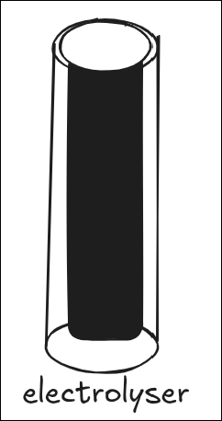
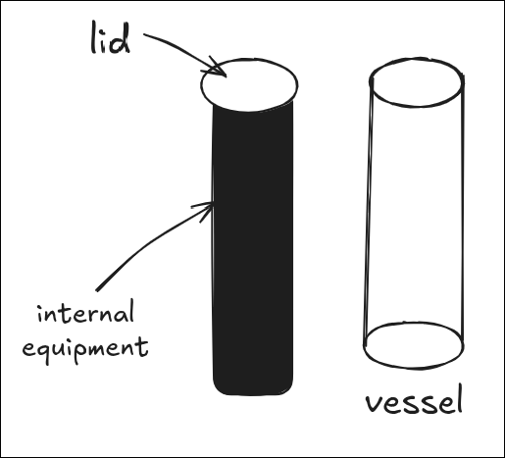
The Situation
Supercritical Solutions operates a large process vessel used in electrolyser systems.
The vessel weighs about
13 tons
measures roughly 870 mm in diameter and
3 metres in internal height.
Attached to the underside of the vessel lid is a
3-ton block of internal equipment (about 2 metres tall).

Slide 3
The Maintenance Challenge
To service or replace the internal equipment, the lid and the equipment block must be lifted completely out of the vessel.
After maintenance, the combined assembly must be lowered back in and precisely seated.
The internal equipment fits very tightly inside the vessel, there is only about 16 cm (6 inches) of clearance on each side.
Because of that small clearance, even a small sideways movement during lowering could cause the equipment to strike the vessel wall, leading to damage or misalignment.

Slide 4
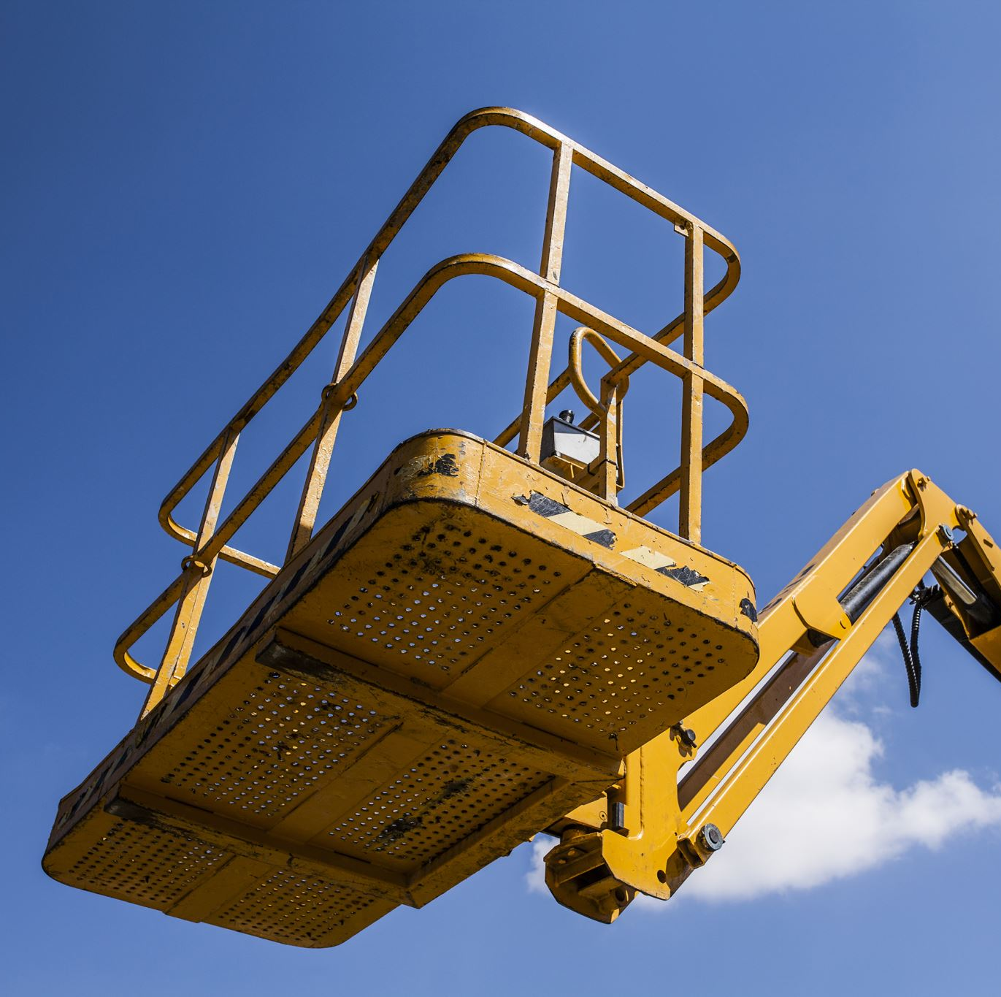
The Core Problem
The current lifting method allows small side-to-side or swinging motion during lowering.
The operation needs a way to guide the lid and equipment assembly precisely into place, straight down, with no lateral movement.

